Slide 1
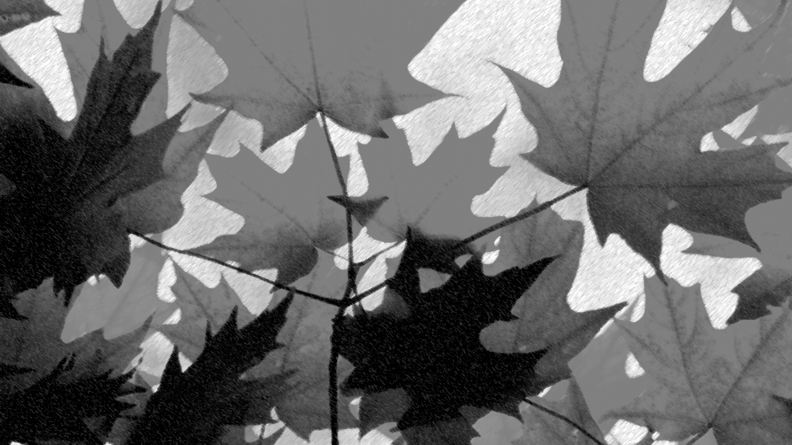
Landfill Presentation
Ali Williams, Senior Civil/Environmental Engineer

Slide 2
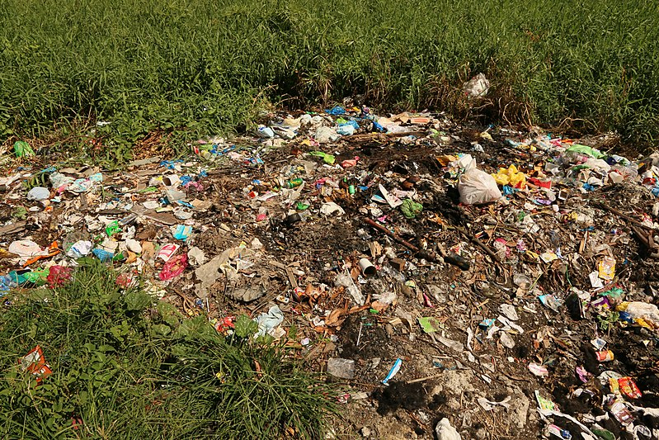
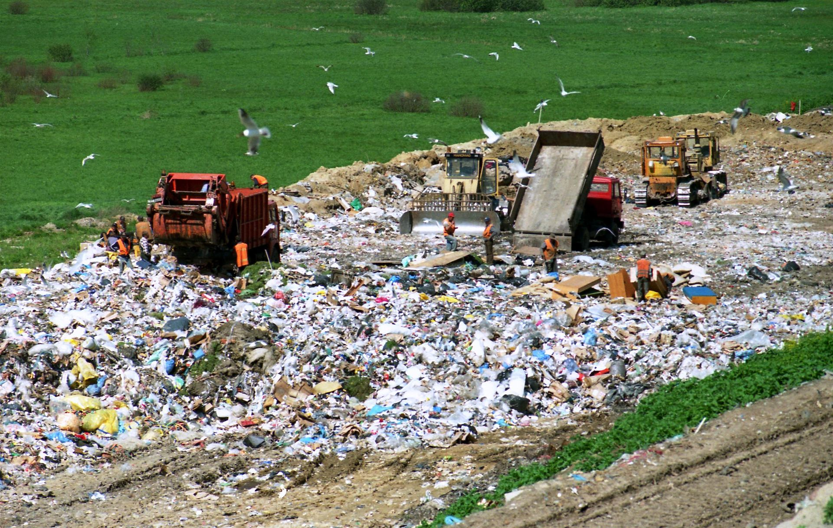
How Is a Landfill Different then a Garbage Dump?
Garbage Dump
An open site where Garbage is dumped in a pile, typically harmful to the surrounding environments
Landfill
An Engineered system designed to store waste in a manner that protects public health and natural resources

Slide 3
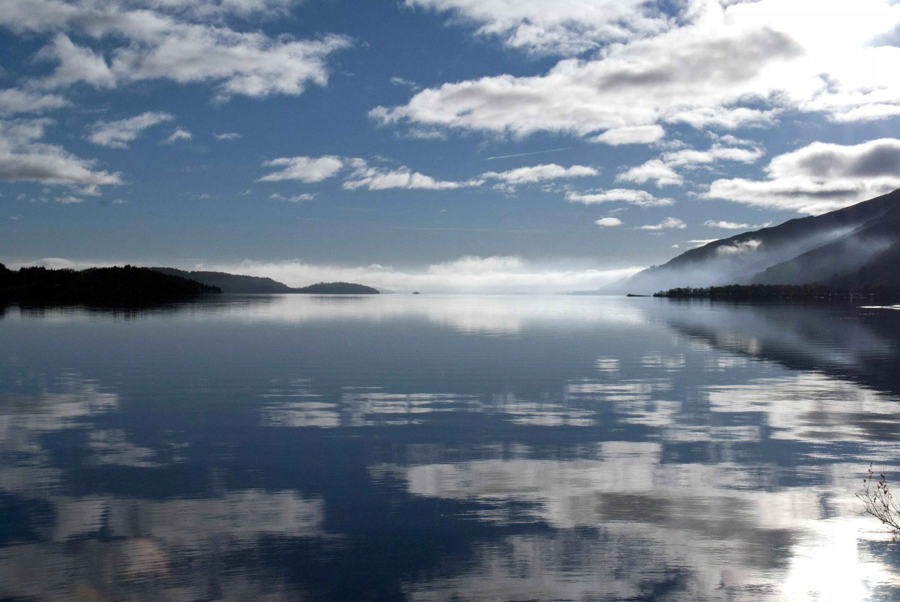
What Makes a Landfill Better Than a Dump?
More environmentally friendly than a Dump
  typically less odours, litter, groundwater and air pollution than dumps
Animals are Less likely to congregate around Landfills then dumps
  Landfills have better barriers and covers
Landfills can be converted into greenspace at the end of their life cycle and dumps cannot
Energy can be generated from the gas produced from the decomposing garbage

Slide 4
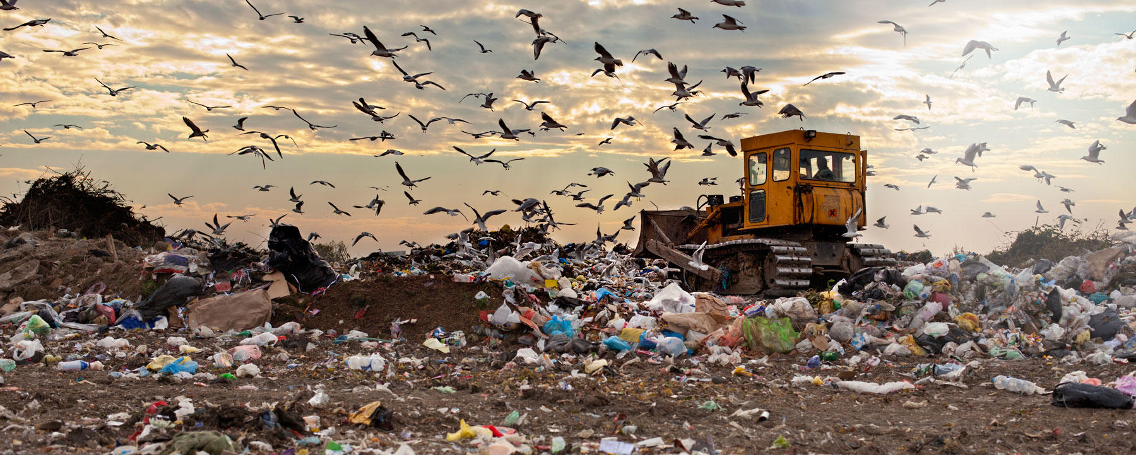
How do Landfills work?
Landfills are engineered to store trash in an environmentally friendly way; this is accomplished in a variety of different ways.

Slide 5
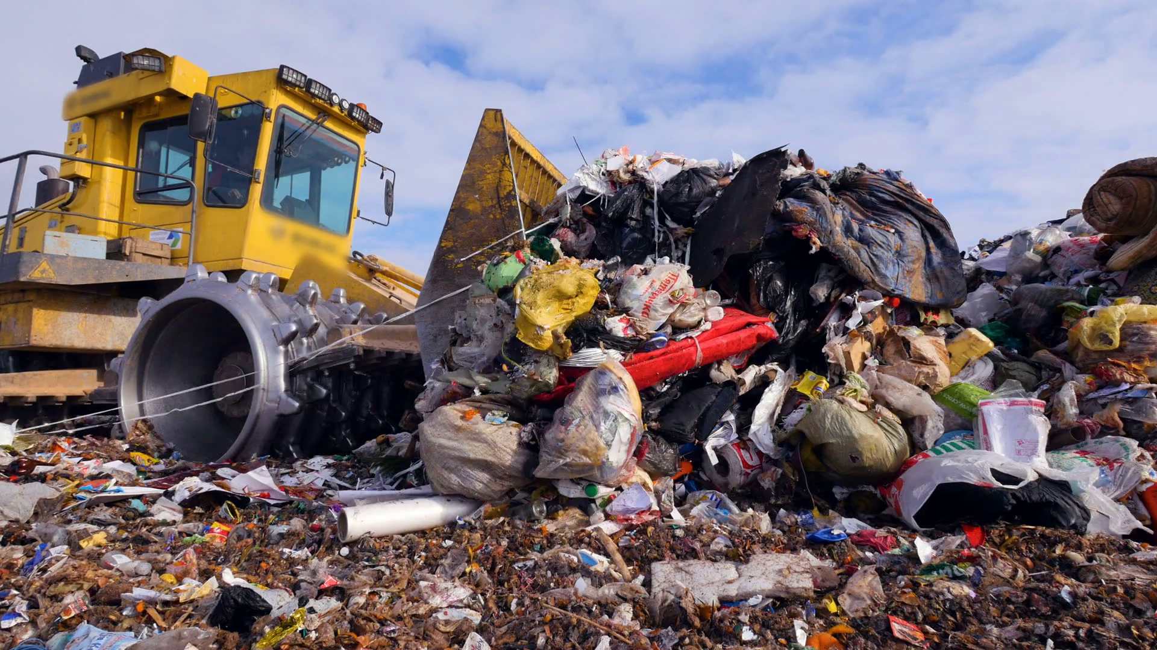
How do Landfills work?
How is Garbage stored?
A hole is dug at the site of the landfill for the trash to be stored in
This trash is then compacted frequently to be as efficient with the space as possible
The Trash is then buried under layers of dirt, this helps the decomposing process and prevents unwanted smells

Slide 6
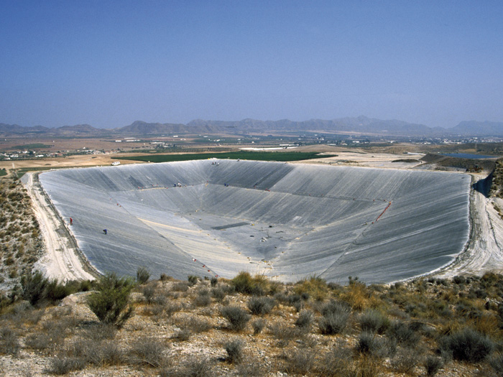
How do Landfills work?
Engineered Liner
The lining is used to help prevent seepage of a substance called Leachate
Leachate: A toxic liquid that is produced when water and solid waste mix
The liner stops the Leachate from seeping into the ground and eventually polluting the Groundwater

Slide 7
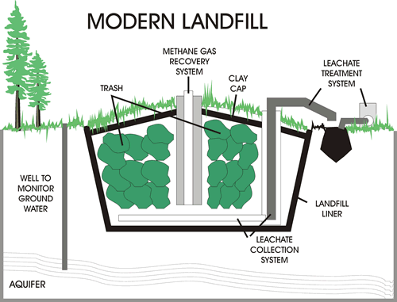
How do Landfills work?
What Happens to the Leachate (I.e Toxic Liquid)?
After the Leachate is blocked by the liner, it is collected at the bottom of the landfill
The Leachate is then treated so it is no longer harmful to the environment

Slide 8
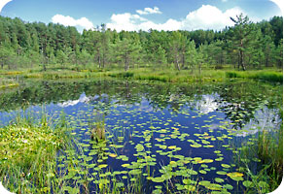
How do Landfills work?
Monitored Natural Attenuation
Some small and remote landfills generate very little amounts of leachate, or the leachate generated is not overly toxic.
A Natural Attenuation Landfill relies on natural soil and water bacteria to breakdown contaminants.
The groundwater and surface water is monitored annually to confirm performance.
LINER EXERCISE

Slide 9
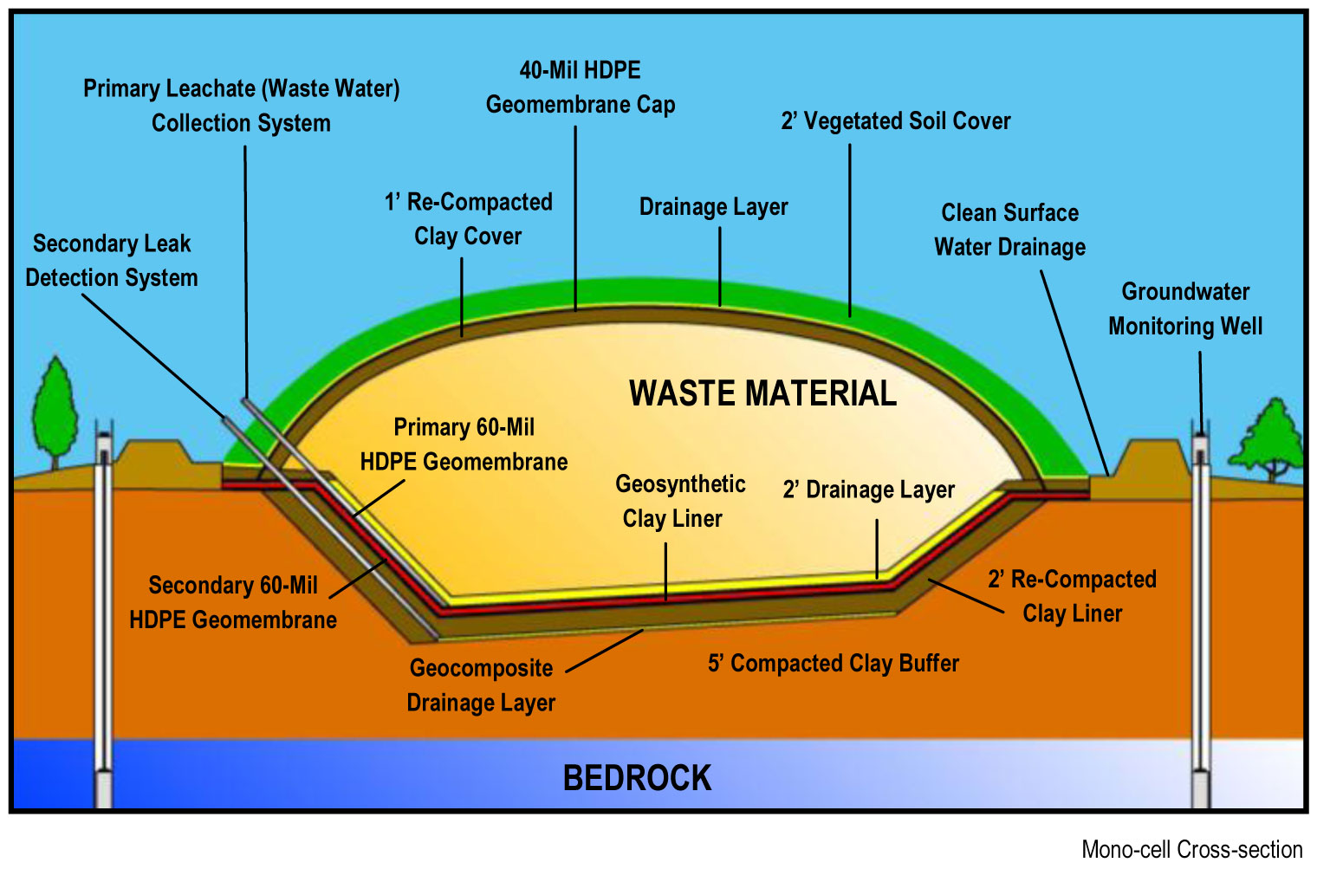
How do Landfills work?
What happens when a Landfill gets full?
At the end of a Landfills life cycle, layers of clay and soil are placed on top to seal off the garbage
For large landfills (more than 1 million cubic meters) a Gas Collection System is then installed to collect any gases that are produced from the decomposing garbage. This Gas can be used to produce electricity or be converted into a form of fuel.

Slide 10
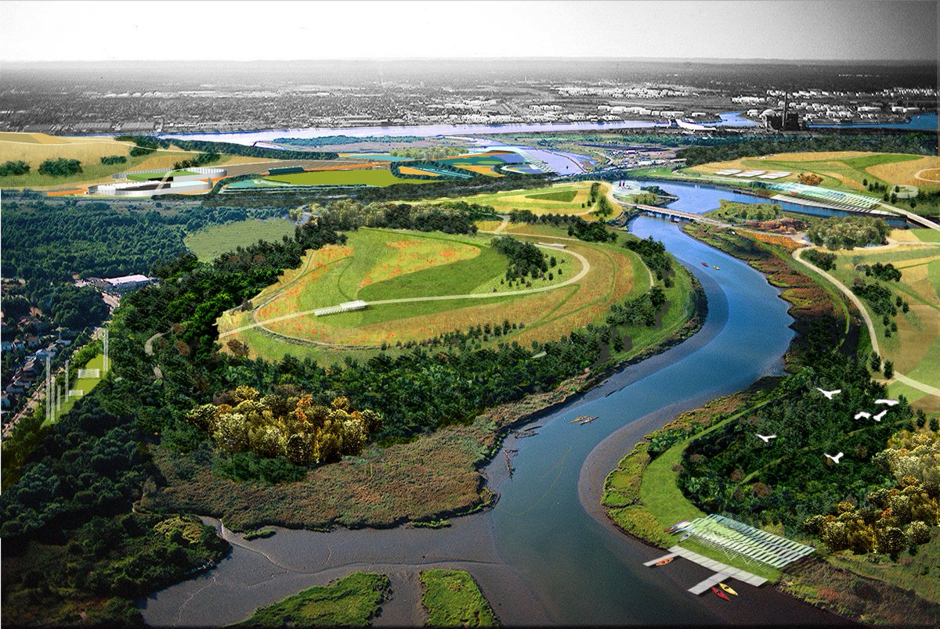
How do Landfills work?
What happens to the land after a Landfill is full?
The Landfill can be converted back to a green space once the area is deemed safe
The site is then continued to be monitored to ensure everything is still functioning as intended
This area used to be a Landfill!

Slide 11
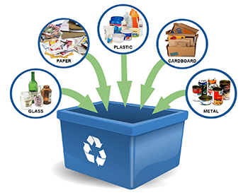
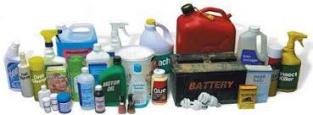
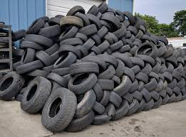
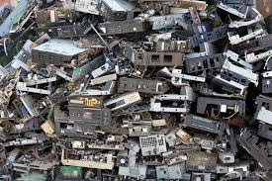
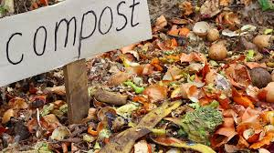
Recycling
In Ontario, some communities recycle or divert the following types of waste:
Blue Box Waste – Plastic, Glass, Metal, Cardbord and Paper
Household Hazardous Waste – Oil, Cleaning Chemicals, Batteries
Used Tires
Electronic Equipment
Food Waste

Slide 12
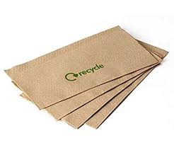

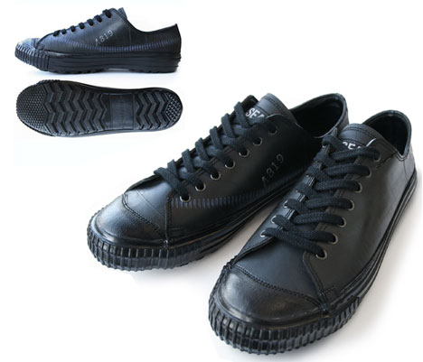
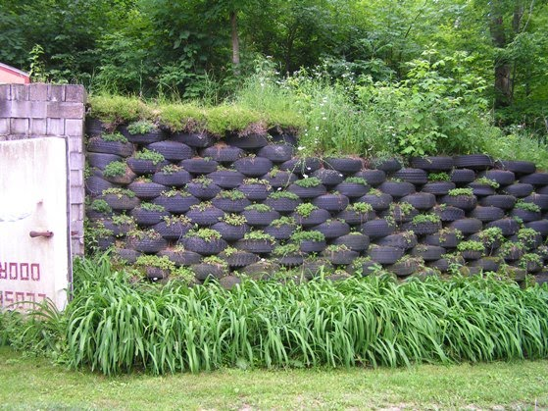
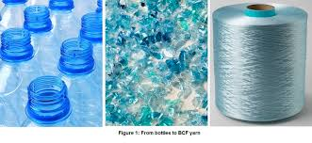
Recycling
But it is better to Reduce and Reuse the waste before it gets to the landfill:
Recycled Paper for office or crafts
Recycled Plastic for Yarn
Used Tires for Shoes, Wall, Decorations and Furniture

Slide 13
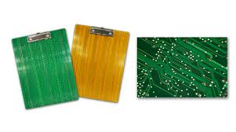
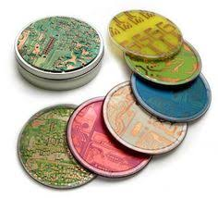
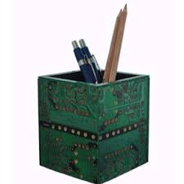
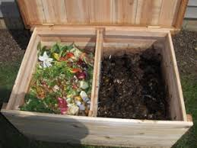
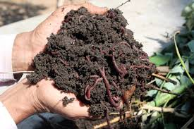
Recycling
But it is better to Reduce and Reuse the waste before it gets to the landfill:
Recycled E-Waste for Office Use
Food Waste For Compost

Slide 14
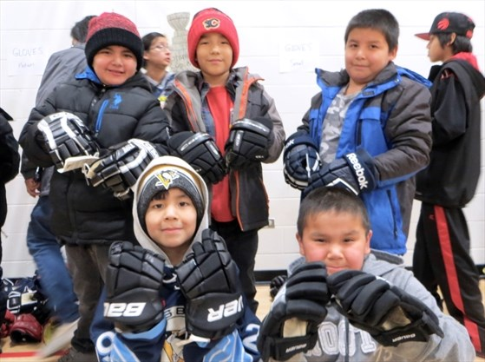
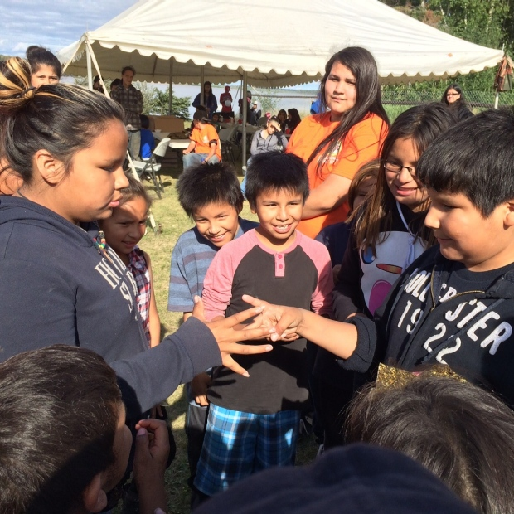
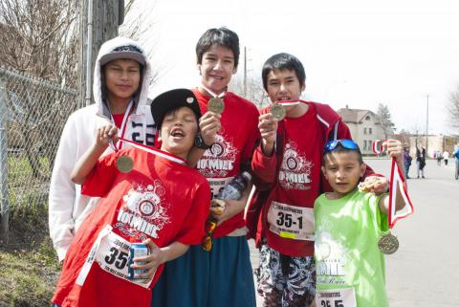
What Can You Do to Help Reduce Waste?
Questions?

Slide 15
Sources
https://commons.wikimedia.org/wiki/File:Garbage_dump,_Talisay,_Cebu.jpg
https://en.wikipedia.org/wiki/Landfill#/media/File:Wysypisko.jpg
https://floatingcovers.wordpress.com/tag/landfill-liners/
http://www.scuolacascia.it/attivita/clil2/webquest/resources/energy%20kids%20page/www.eia.doe.gov/kids/energyfacts/saving/recycling/solidwaste/landfiller.html

